Slide 1



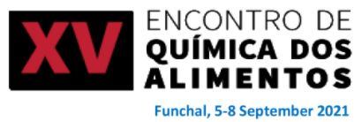


New alternatives to milk from pulses: digestibility and bioactivity
Carla Margarida Duarte
September 7th 2021

Slide 2

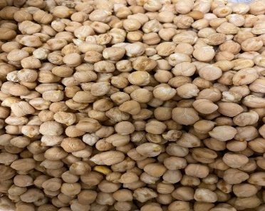
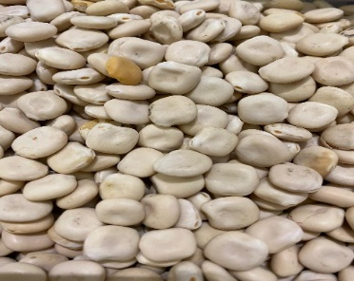

Contextualization
There is a high demand for milk substitutes other than soy beverages for different reasons (health, ethical grounds - environmental impacts).
However, plant-based current offers are essentially poor in protein content (less than 1.5% against the 3.5% in milk):
- cereal and nuts based beverages show values between 0,1 and 1,5%.
One possible solution could be the use of European pulses with high protein content, such as
Chickpea
Lupin
Notes:
Plant-based beverages are a fast growing segment in food market.

Slide 3



Main objectives
This work aimed to evaluate the processing impact on
a) keeping nutritional characteristics of pulse beverages;
b) strive to achieve best digestibility - through quantification of protein and minerals bioaccessibility;
c) specific bioactivities maintenance, such as inhibition of gelatinolytic enzymes (metalloproteinases MMP-9) involved in cancer and inflammation.

Slide 4
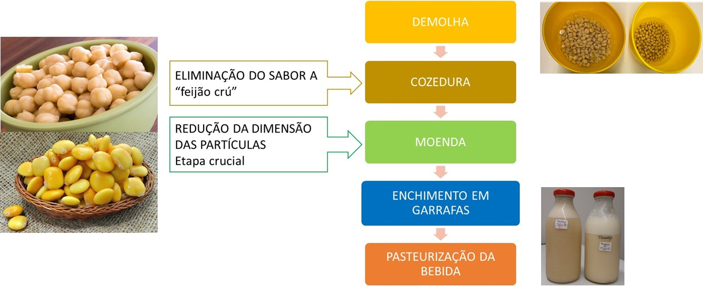
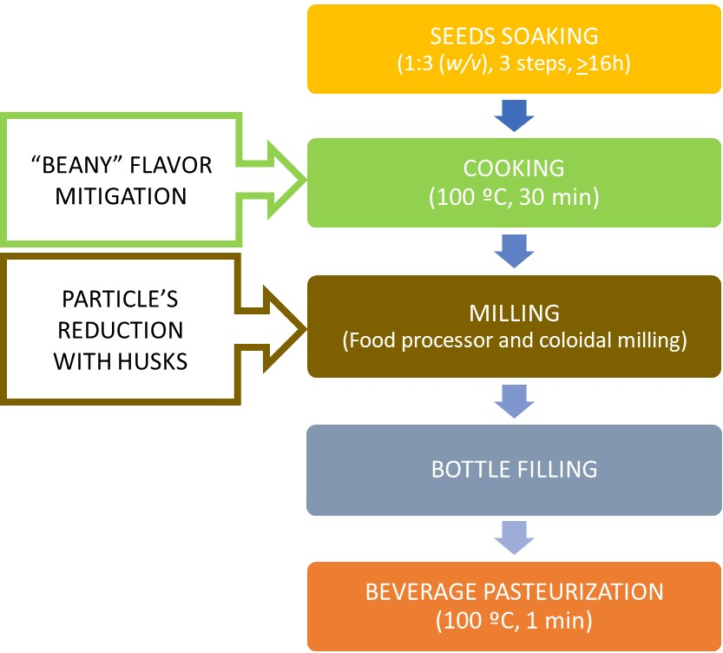
Pulse beverages production
The whole seed was used (not the protein isolate) and the okara residue was minimized to obtain “clean label” beverages.
Bimby + Ultraturrax – 14% okara
colloidal milling – 2% okara
10% (w/v) of dry seeds in the final beverage

Slide 5
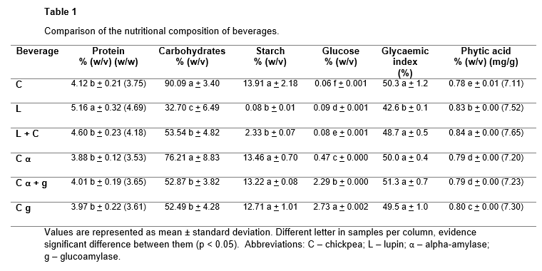
Results
Protein content
significant higher in lupin beverage (5.16% (w/v)), when compared to all digesta,
chickpea-based beverages - 4% (w/v) average.
Starch values confirm its elution from seeds during processing.
All pulse beverages produced in this study are low-GI foods (< 55), which the most significant was lupin.

Slide 6
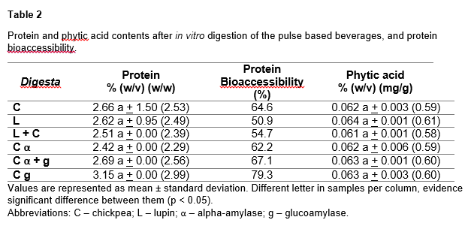
Results (cont.)
After in vitro digestion, the digesta were analyzed:
protein
phytic acid
minerals
lectin
Phytic acid did not inhibited the digestive enzymes during in vitro digestion, nor impaired protein digestibility.
Lower bioaccessibility in lupin beverage (protein was digested in greater extension) due to:
simpler matrix complexity
access of digestive proteases to proteins
proteolysis efficiency
Notes:
The comparison between protein and phytic acid results of beverages (Table 1) and respective digesta (Table 2), showed a decrease for every samples, as expected, demonstrating that the lowest beverage contents of phytic acid did not inhibited the digestive enzymes during static digestion, nor influenced protein digestibility.
As known, phytic acid can form a complex with proteins, altering its structure, making them less soluble, and this affects the enzymatic degradation and peptic digestion ).
Despite that, the results showed the opposite and were supported by the good bioaccessibility of the produced peptides during the in vitro digestion for all beverages: from 50.9% for lupin beverage to 79.3% for chickpea beverage with glucoamylase (Table 1).

Slide 7
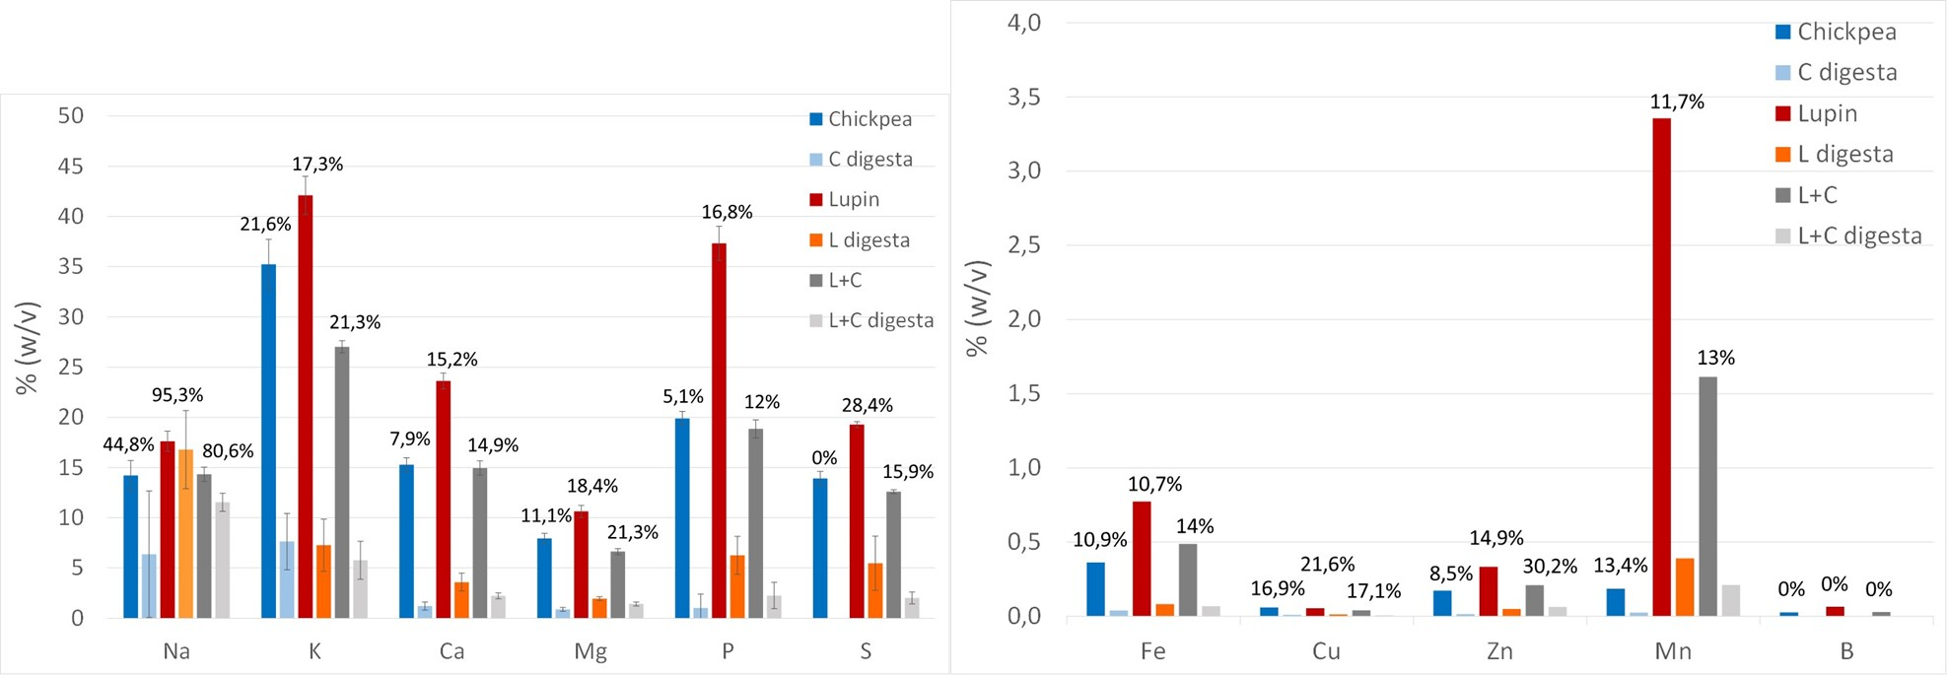
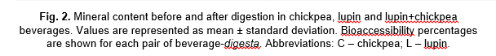
Results (cont.)
Low phytic acid contents (before digestion: 0,8% and after: 0.062%) did not evidence interference in mineral digestion, as divalent cations showed bioaccessibility:
Ca 7.9 to 27.5%; Mg 9.9 to 21.3%; Fe 10.7 to 39%; Zn 0 to 30.2%.
Notes:
The lupin beverage presented a broad profile with more representative molecular weights than chickpea beverage. Some proteins with persulfide bonds shown in pulse beverages and digesta (Figure 1 (a)), were revealed as polypeptides with lower molecular weight in the polyacrylamide gel submitted to reducing conditions (Figure 1 (b)) (e.g polypeptides between 30-40 kDa in chickpea beverage; stronger concentration of polypeptides in lupin beverage between 35-45 kDa, around 30 kDa and between 13-20 kDa).
The electrophoretic profile of the enzyme-blank sample is clear and similar to the beverage´s digesta, evidencing all the expected enzymes used during the protocol. The α-amylase used has an expected molecular weight around 58-62 kDa, the pepsin 36 kDa and pancreatin is a group of several enzymes with molecular weight that reach from 13 to 64 kDa (Figure 1).

Slide 8
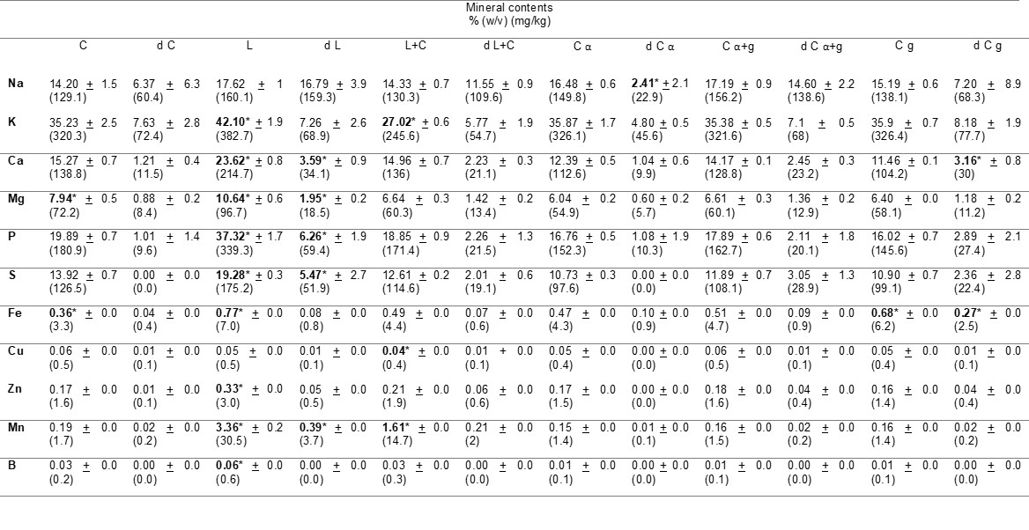
Results (cont.)
Table 3 - Mineral content in pulse-based beverages and after in vitro digestion.
Values are represented as mean ± standard deviation. *represent a statistically significant result per mineral element (p < 0.05).
Abbreviations: C – chickpea; L – lupin; α – alpha-amylase; g – glucoamylase; d – digesta.
Notes:
As shown, lupin beverage and respective digesta are the ones whith the most significant mineral content when compared to other samples…… (confirmar)

Slide 9
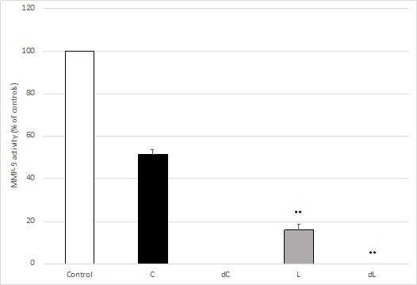
Results (cont.)
Both beverages presented very significant inhibitory activities against MMP-9 (P<0.001): Lupin beverage (85%) and chickpea beverage (51%).
Fig. 3. The effect of the beverage and digesta extracts (L - lupin, dL – lupin digesta, C – chickpea, dC – chickpea digesta) on MMP-9 gelatinolytic activity, measured by the DQ-gelatin assay. MMP-9 activity is expressed as relative fluorescence as a % of controls and correspond to the means of at least three replicate assays (n = 3) ± SD. * p < 0.05, ** p < 0.001.
Notes:
However, despite most lectins are resistant to degradation by digestive enzymes, lectin´s activity was clearly reduced in these beverages after digestion, showing that the cooking step used for beverage production was successful for protein inactivation and allowance for its nutritional increase.

Slide 10
Results (cont.)
The inhibitory activities were maintained and even enhanced upon in vitro digestion with a complete reduction of MMP-9 activity,
Suggesting a resistance to the proteolytic activities of the digestive enzymes.

Slide 11
Conclusions
Palatable and nutritionally rich pulse-based beverages which can offer a sustainable alternative to cow milk, including to dairy proteins intolerance.
Pulse beverages are as good sources of protein as cow milk, and presented low-glycaemic index.
The anti-nutritional compounds (phytic acid and lectins) did not hinder minerals bioaccessibility.
Mineral content of pulse beverages especially in Ca, Mg and P, is much lower comparing to milk. Algae could be added to increase its mineral content.
Lupin and chickpea based beverages are highly digestible and evidenced specific bioactivities suggesting a strong potential as a functional food, in preventive diets against inflammatory and cancer diseases, especially related to the digestive system.
.
Notes:
However, despite most lectins are resistant to degradation by digestive enzymes, lectin´s activity was clearly reduced in these beverages after digestion, showing that the cooking step used for beverage production was successful for protein inactivation and allowance for its nutritional increase.

Slide 12

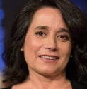





Acknoledgments
This work was supported by the FCT Project PTDC/BAA-AGR/28370/2017: “Leite de proteína vegetal a partir de leguminosas europeias com potencial bioativo” through the research unit UID/AGR/04129/LEAF.
Joana Mota
Ana Cristina Ribeiro
Carla Martins
Ricardo Assunção
Anabela Raymundo
Ana G Lima
Isabel Sousa
Cristiana Nunes
Carla M Duarte
carladuarte@isa.ulisboa.pt
Ricardo B Ferreira
Notes:
The simple technological process used in this work allowed the formulation of palatable and nutritionally rich pulse-based beverages which can offer a sustainable alternative to cow milk, including to dairy proteins intolerance. Results also suggested that pulse beverages are as good sources of protein as cow milk, and presented low-glycemic index. Nevertheless, the studied anti nutritional compounds (phytic acid and lectins), naturally present in pulse seeds, are highly reduced through beverage’s processing and did not hinder minerals bioavailability.
In addition, besides being highly digestible, lupin and chickpea beverages evidenced specific bioactivities such as inhibition of gelatinolytic enzymes involved in inflammation and cancer.

Slide 13



