Slide 1
Consciência e Luminosidade
João Branquinho
Universidade de Lisboa
Sinopse: Argumenta-se indirectamente a favor do fisicalismo acerca da mente mostrando que uma maneira influente de argumentar contra ele, de natureza modal, não é convincente, pois envolve uma concepção errónea da consciência, a luminosidade desta
Ramos da Filosofia envolvidos: Filosofia da Mente (Mente-Corpo, Consciência, Fenomenologia), Epistemologia (Conhecimento, Luminosidade), Metafísica (Modalidade, Aparência/Realidade)
A Luminosidade da Alma: "Não sabemos da alma senão da nossa” (Fernando Pessoa)
A sabedoria de Brian Eno (Put a Straw under Baby): “There's a brain in the table,
There's a heart in the chair. And they all live in Jesus, It's a family affair.”

Slide 2
Type Physicalism
The issue of the relation between human mind and human body – or, more relevant to our present concerns, between conscious or phenomenal states (pains, colour sensations, orgasms) and the brain states that are (according to the best neuroscience) their neural correlates – is perennial and continues to receive a lot of attention in contemporary philosophical thinking
We discuss some aspects of the issue having in mind recent developments in the philosophy of mind and consciousness
The view on the mind-brain problem known as Type Physicalism, or Central State Materialism, is the view that every type of instantiated mental state is strictly identical to some type of brain state – or, better, some state of the central nervous system
One natural way to construe mental types is to regard them as mental properties or features
But mental properties may be conceived in two different ways

Slide 3
Type Physicalism
(a) They may be taken as features of mental particulars, in the sense in which the property of being a pain can be instantiated by specific pain events or experiences had by persons or animals
(b) Or they may be taken as features of creatures, in the sense in which the property of being in pain can be instantiated by a person or animal on a particular occasion
There is thus a distinction between the property of being a pain, which is predicable to mental phenomena, and the property of being in pain, which is predicable to a certain set of organisms
Although there are differences between these two ways of taking mental properties (one who is sceptical about the very idea of a token mental state would not adopt the former construal but might accept the later), the distinction is relatively irrelevant to our purposes

Slide 4
Type Physicalism
Type physicalism is thus the view that every instantiated mental property, e.g. the property of being a pain, is identical to some property of the brain or central nervous system, some pattern of brain or nervous activity, say C-fiber firing/A-Δ fiber firing
Type physicalism is the strongest physicalist view on the mind-body problem
In particular, type physicalism is entailed by, but does not entail, the other two brands of the so-called Identity Theory of Mind, the general view that the mind is nothing over and above the brain (or the central nervous system)

Slide 5
Type Physicalism
First, type physicalism is entailed by so-called Token Physicalism, the view that every token mental state (say a particular pain) is identical to some token brain state (say a specific firing of C-fibers)
According to token physicalism, there are not in the world particulars of two disparate kinds: on the one hand, specific mental episodes such as the pain felt by Socrates on a certain occasion; and on the other specific physical episodes such as the firing of neurons taking place on Socrates’s brain on the occasion
The world consists entirely of physical particular states and occurrences
Second, type physicalism is entailed by so-called Substance Physicalism, the view that the mind is nothing over and above the brain (or central nervous system)

Slide 6
Type Physicalism
According to substance physicalism, there are not in the world two distinct substances: the mental and the physical, the material and the immaterial, the conscious mind and the brain
The world consists entirely of physical things, things ultimately made of matter
Hence, if one has a case against type physicalism, one has thereby a case against token physicalism, as well as a case against substance physicalism
Type physicalism has been brilliantly expounded and defended by David Lewis in a series of seminal papers, such as the 1966 paper An Argument for the Identity Theory (Journal of Philosophy, 63: 17–25) and the 1995 paper Should a Materialist Believe in Qualia? (Australasian Journal of Philosophy, 73: 140–144).

Slide 7
Type Physicalism
Type physicalism has been, also brilliantly, challenged by Saul Kripke (in Lecture III of his book Naming and Necessity. Oxford: Blackwell, 1980) and by David Chalmers (e.g. in Chapter 4 of his book The Conscious Mind. Oxford: OUP, 1996)
Of special significance in Kripke’s and Chalmer’s attacks on type physicalism are the modal arguments they employ to the effect, arguments which are supported by seemingly strong Cartesian intuitions about the possibility of dissociating the physical from the mental, or (better) the physical from the conscious or the phenomenal

Slide 8
Type Physicalism
I want to examine some aspects of a familiar modal argument against type physicalism
Although my concerns are not exegetical, and although I am aware of differences holding between Kripke’s and Chalmers’s modal rebuttals of type physicalism, the argument in question combines features of Kripke’s modal argument with features of Chalmer’s modal argument, in spite of being slightly more Kripke than Chalmers in some respects
Here is the reconstructed modal argument, labelled for convenience The Kripke-Chalmers Modal Argument

Slide 9
The Kripke-Chalmers Modal Argument
Premise 1 (Type Physicalism): If type physicalism is true, then every type of phenomenal mental state M, e.g. Pain, is identical to some type of brain state F, e.g. C-Fiber Firing
Premise 2 (The Necessity of Identity): There are no contingently true identities, all identities are necessarily true (if true at all)
Conclusion 1: If mental state M is identical to brain state F, then it is impossible that M be distinct from F
Premise 3 (The Physical without the Mental): It is conceivable that brain state F occurs in (or is instantiated by) some creature without mental state M occurring in (or being instantiated by) that creature
The creatures in question may be either ourselves (Kripke’s version) or philosophical zombies (Chalmers’s version)
Philosophical Zombies are beings physically and behaviourally (or functionally) indistinguishable from us, but utterly deprived of consciousness, in the sense of conscious states, states characterized by their phenomenology, by the what-is-like-to-be-in such states

Slide 10
The Kripke-Chalmers Modal Argument
Philosophical Zombies can have Zombie C-fibers firing in their Zombie brains, and they can behave as we behave when we are in pain, but they don’t feel anything
The idea is not that there are such creatures roaming around, but only that they are conceivable
Premise 4 (Conceivability entails Possibility): Necessarily, if something (a situation, a proposition) is conceivable, then it is possible
Conclusion 2: It is possible that brain state F occurs in some creature without conscious state M occurring in that creature
Conclusion 3: It is possible that M be distinct from F
Conclusion 4: M is actually distinct from F
Final Conclusion: Type physicalism is false

Slide 11
Premise 2
Chalmers’s modal argument is not formulated in terms of strict identity between mental and physical types, but in terms of a weaker relation of logical supervenience between mental and brain properties
But this is irrelevant to our present concerns, as our focus will be on Premises 3 and 4, whose conjunction alone entails failure of logical supervenience of mental properties over brain properties
Premiss 2 (The Necessity of Identity) is a logical consequence of a theorem of standard quantified modal logic: necessarily, for any objects x and y, if x is identical to y, then it is necessary that x be identical to y
Before Kripke, it was very common to regard psychophysical identities, statements such as Pain is C-fiber firing, as being of the same sort as theoretical identities, identity statements established by science suh as Water is H20 and Heat is molecular motion (roughly)

Slide 12
Premise 2
Like the latter identities, psychophysical identities would have an empirical nature and would thus be only contigently true (if true)
It was along these lines that psychophysical identities such as Pain is C-fiber firing were viewed by the early advocates of type physicalism, most notably U.T. Place and J.J.C. Smart
With Kripke, and with the development of quantified modal logic due to him and others, such a view became much harder to sustain, not only with respect to psychophysical identities but also with respect to theoretical identities
However, one should note that even logical truths are not beyond rational dispute, for such a status is not absolute and can always be challenged by advocates of alternative, non standard, logics
For instance, the necessity of identity is not a validity in the counterpart theory for quantified modal logic developed by David Lewis

Slide 13
Luminosity
On Lewis’s approach to the mind-body problem, which combines type physicalism and analytical functionalism, psychophysical identities such as Pain is C-fiber firing are only contingently true
Premise 3 is the crux of the modal argument, at least to the extent that it relies on allegedly controversial Cartesian intuitions about the conceivability and possibility of certain scenarios
I want to show that a usual way of arguing for Premise 3 on the basis of such intuitions, a line of reasoning clearly employed by Kripke and also endorsed by Chalmers, seems to be implicitly committed to the luminosity of consciousness, to the idea that phenomenal states are luminous
As introduced by Timothy Williamson (Knowledge and Its Limits. Oxford: OUP, 2000, Chapter 4), the notion of luminosity applied to phenomenal states boils down to the following claims

Slide 14
Luminosity
Luminosity (a): if a subject s is in a phenomenal state M at a time t, then s is in a position to know at t that s is in M
If someone is in pain on a given occasion, then she is in a position to know on the occasion that she is in pain
Luminosity (b): if a subject s is not in a phenomenal state M at a time t, then s is in a position to know at t that s is not in M
If someone is not in pain on a given occasion, then she is in a position to know on the occasion that she is not in pain

Slide 15
Luminosity
Luminosity goes from metaphysics, from the obtaining or failing to obtain of given conditions in the world, to epistemology, the knowledge of their obtaining or failing to obtain
Luminosity gives thus expression to the idea that the realm of the conscious, or the phenomenal, is epistemically transparent to the subject
Now we have reasons to suspect that, at least as usually developed, the Kripke-Chalmers modal argument is committed to the luminosity of consciousness, being thus at bottom an epistemic argument
Here is then the supporting argument for Premise 3 where Luminosity seems to be involved

Slide 16
The Case for Premise 3
Premise A: It is not conceivable that a conscious state M, pain, occurs in a creature, without the characteristic phenomenology of M, the way pain is felt (the-what-is-like-to-be-in-pain), occurring in that creature
It is not conceivable that what actually is a pain is not felt as pain, that it lacks the phenomenology of pain
Premise B: It is conceivable that a brain state F, C-fiber firing, occurs in a creature without being accompanied by the phenomenology of the correlated conscious state M (or by any phenomenology at all, for that matter), that is to say, without being felt as pain by the creature
Conclusion: It is conceivable that brain state F, C-fiber firing, occurs without phenomenal state M, pain, occurring (= Premise 3)

Slide 17
The Case for Premise 3
Kripke famously introduced the following thought experiment (Kripke 1980: 153-4) in defence of Premiss B (the conceivability of the physical without the phenomenal)
And Chalmers seems to share Kripke’s intuitions here (Chalmers 1996: 124, 148-9)
Suppose God created the entire universe with a single stroke
In order to create heat, would it be sufficient for God to create the motion of molecules?
A positive answer is expected
Contrast with the psychophysical case
In order to create pain, would it be sufficient for God to create beings with C-fibers firing in their brains (or any of the phenomena identified by the best neuroscience as the neural correlate of pain)?

Slide 18
The Case for Premise 3
The intuitions of Kripke and Chalmers favour a negative answer
God would still have to do something else to generate pain: to arrange things so that C-fiber firing be felt as pain
Likewise, just by creating the motion of molecules, God would not have thereby created the sensation of heat (in contrast with heat itself)
God would have to further arrange things so that the motion of molecules be felt as heat
Now the luminosity of phenomenal states, at least in the sense of Luminosity (a), seems to be assumed in a natural reading of Premise A

Slide 19
Luminosity in the Modal Argument (a)
The underlying Kripkean claim, that there are no unfelt pains, has a non-trivial, epistemic reading on which if someone is in pain, then her pain should be felt as such, as pain, i.e. with the pain phenomenology, with the distinctive phenomenological quality of pain
On that reading, a pain being felt as pain by a subject in pain entails that it seems to the subject that she is in pain
Thus, whenever someone is in pain, it must seem to her that she is in pain, and then she is bound to be aware that she is in pain
Hence, someone in pain is at least in a position to know that she is in pain (if she possesses the concept of pain and reflects upon her experience, she actually knows that she is in pain)

Slide 20
Luminosity in the Modal Argument (a)
Therefore, upon the epistemic reading of the Kripkean claim that there are no unfelt pains, which seems to be the required one, the above way of arguing for Premise 3 of the modal argument commits it to Luminosity (a)
The Kripkean claim, taken on that reading, is also endorsed by Chalmers
Here are two passages taken from The Conscious Mind (Chalmers 1996:149) that clearly illustrate that (especially the second)
… to be a pain is to feel like pain in every possible world. (That is, the secondary intension and the primary intension of “pain” coincide.)
The feel of pain is essential to pain as a type – but that is just a fact about what “pain” means

Slide 21
Luminosity in the Modal Argument (a)
Before proceeding to Premise 4, and to the Luminosity also present therein, let me expand on what I have called the epistemic reading of the claim that there are no unfelt pains, that is to say, the claim
Necessarily, if x is in pain, then x feels pain
Necessarily, if y is a pain had by x, then y is felt like pain by x
Now there presumably is a “trivial”, non-epistemic reading of this claim, where just the pain sensation – the phenomenological quality, the feel of pain – is involved, where a pain is felt as pain simpliciter (so as to speak)

Slide 22
Luminosity in the Modal Argument (a)
But there is also a markedly epistemic reading of the claim, a reading on which the pain sensation is taken together with its categorization as such by the subject, a reading on which a pain is felt as pain in the sense of its being brought by the subject under the phenomenal concept of pain
I shall come back to the “trivial” reading later on
What I would like to emphasise now is that the epistemic reading seems to be the one underlying Kripke’s and Chalmers’s considerations

Slide 23
The Case for Premise 4
Premise 4 has been the object of intense discussion and has been challenged very often
A lot depends on the intended notion of possibility, which for Chalmers is logical possibility, the most inclusive kind of possibility
However, our only concern with Premise 4 is that there is a way of arguing for it, clearly employed by Kripke and also endorsed by Chalmers, that also seems to commit the modal argument to the luminosity of consciousness
Indeed, the way putative counter-examples to Premise 4 are dismissed, especially by Kripke, seems to bring about such commitment
To block putative counter-examples, alleged cases where one conceives the impossible or imagines impossible propositions, Kripke introduces the idea of an illusion of conceivability or contingency

Slide 24
The Case for Premiss 4
There is sometimes the illusion that an act of conceiving a proposition is taking place, whereas what actually is taking place is an act of conceiving a different but epistemically identical proposition, i.e. the same proposition as viewed “from the inside”, on the basis of phenomenology only
The proposition actually conceived is a proposition epistemically indistinguishable from the proposition seemingly conceived in the following sense
It seems to be the same proposition on the basis of phenomenology, on the basis of the way the world appears to us
What we imagine when we think we imagine that water is not H20 is not a situation where water itself lacks its actual chemical composition, but a situation where some other liquid phenomenologically indiscernible from water (tasteless, transparent, etc.), experienced by us as if it were water, is not H20

Slide 25
The Case for Premiss 4
However, this gap between reality (what is the case) and appearance (what seems to us to be the case) does not extend to the psychophysical case, to the realm of the conscious
Here there are just no illusions of conceivability and hence it is indeed conceivable, and therefore possible, that brain state F be instantiated without conscious state M being instantiated (Premiss 3)
An illusion of conceivability in the psychophysical case would boil down to the following
What we imagine when we think we imagine that pain is not the firing of C-fibers is not a situation where pain itself is not such brain state, but some epistemically indistinguishable situation where some other experience which has the phenomenology of pain, which is felt by us as pain, is not a firing of C-fibers

Slide 26
Luminosity in the modal argument (b)
But this is absurd, for if an experience has the phenomenology of pain, if it is felt by us as pain, then it is bound to be a pain
Just as there can’t be unfelt pains, so there can’t be states felt as pains that are not pains
In the realm of the conscious there is no room for a gap between appearance and reality
If something I experience seems to me to be a pain, then it actually is a pain
Conversely, whenever I am not in pain, the “feel” of pain is missing, nothing that is going on is felt as pain by me
Thus, whenever I am not in pain, it must seem to me that I am not in pain, and then I am bound to be aware that I don’t feel pain

Slide 27
Luminosity in the modal argument (2)
Hence, if am not in pain, then I am at least in a position to know that I am not in pain (which is Luminosity(b))
As Kripke puts it :
“To be in the same epistemic situation that would obtain if one had a pain is to have a pain; to be in the same epistemic situation that would obtain in the absence of pain is not to have a pain…. Pain … is not picked out by one of its accidental properties; rather it is picked out by its immediate phenomenological quality…. If any phenomenon is picked out in exactly the same way that we pick out pain, then that phenomenon is pain.” (1980: 152-3)
“…in the case of mental phenomena there is no ‘appearance’ beyond the mental phenomenon itself” (1980: 154)
To take stock: we have argued that the luminosity of consciousness is involved in the modal argument against type physicalism in two ways

Slide 28
Anti-Luminosity
(a) Via a reasonable reading of a familiar direct argument for Premise 3, an argument resting upon Cartesian modal intuitions about the dissociation of the physical from the conscious
(b) Via a reasonable reading of a familiar indirect argument for Premise 4, an argument resting upon the idea that there is no room for a reality/appearance distinction in the realm of the conscious
Now the luminosity of the mental in general, and of the conscious in particular, has recently been attacked by Williamson (KAIL, Chapter 4)
I am inclined to think that Williamson’s Anti-Luminosity arguments are forceful
If one assumes Anti-Luminosity, one has good reasons to reject the Kripke-Chalmers modal argument against type physicalism, or at least the aforementioned construal of it
Although I will not go into the details of Williamson’s arguments, here is a simple case he introduces as a counter-example to the luminosity of pain (KAIL, pp. 24, 106)

Slide 29
Anti-Luminosity
The target is only Luminosity (a), but the case could be easily modified so as to undermine Luminosity (b)
First, notice that pain and other conscious states sometimes gradually subside, so that e.g. a state which starts to be a skin pain, a neuropathic pain, may subside, vanish and give rise to a state that is no longer a pain, but a strong skin rash or irritation
Then consider someone with too little self-pity, someone who may come to mistake on a given occasion what is actually a skin pain for a skin rash
The skin pain she has on the occasion is mild, it is a pain whose phenomenology is hardly discernible from the phenomenology of an aggressive skin irritation
Hence, the subject is indeed in pain on the occasion, but she is not then in a position to know that she is in pain
For it seems to her that she is not then in pain

Slide 30
Anti-Luminosity
One might say that the subject´s actual pain is not felt as pain by her (on the epistemic reading of this phrase)
Otherwise, it would seem to her that she is in pain on the occasion (which is clearly not the case)
Perhaps on the basis of background beliefs associated with her too little self-pity, the subject just processes wrongly the phenomenology
Her pain is not felt as pain, is not associated with the pain phenomenology, but is felt as irritation, is associated with the different but epistemically similar phenomenology of irritation
Thus, supposing that she is endowed with the appropriate concepts and reflects on her experience, the subject wrongly categorizes her state not as a state of pain, but as a state of irritation

Slide 31
Anti-Luminosity
Of course, the above reflection assumes that there is more to pain than phenomenology (the total experience of pain includes other components, such as sensorimotor, affective and cognitive aspects)
But this is how it should be, for the upshot of our discussion is precisely that the opposite Kripkean view, that pains are necessarily felt as pains, is mistaken (at least if given the epistemic reading)
Notice that the target of the above anti-luminosity cases is only the epistemic reading of the claim that there are no unfelt pains: the sensation itself, the feel of pain, is indeed present, but it is confused with a very similar feel and is thus wrongly categorized
However, there are reasons to believe that even the “trivial”, non epistemic reading of the claim is mistaken

Slide 32
Anti-Luminosity
Evidence from neuroscience (Grahek 2007: 107-111) seems to show that there are actual cases of dissociation of pain from the phenomenology of pain
Those are cases where subjects (with selective lesions of certain areas of their cortices) are in pain – the pain affect is present – but do not feel pain – the sensation of pain is absent (cases of painfulness without pain)
On the other hand, there seems to be also evidence (Grahek 2007: 41-50) that the converse dissociation, that of the phenomenology of pain from pain, actually takes place
Cases of the syndrome known as pain asymbolia are reported as cases where subjects feel pain – the sensation is present – but are not in pain – the pain affect is absent (cases of pain without painfulness)

Slide 33
Conclusion
Our overall result is a modest one
We have only shown that a particular but usual way of formulating and supporting the modal argument against type physicalism is wrong, to the extent that it relies on a wrong view, the Luminosity of the Phenomenal
We have not shown that every way of formulating and supporting the modal argument is wrong

Slide 34
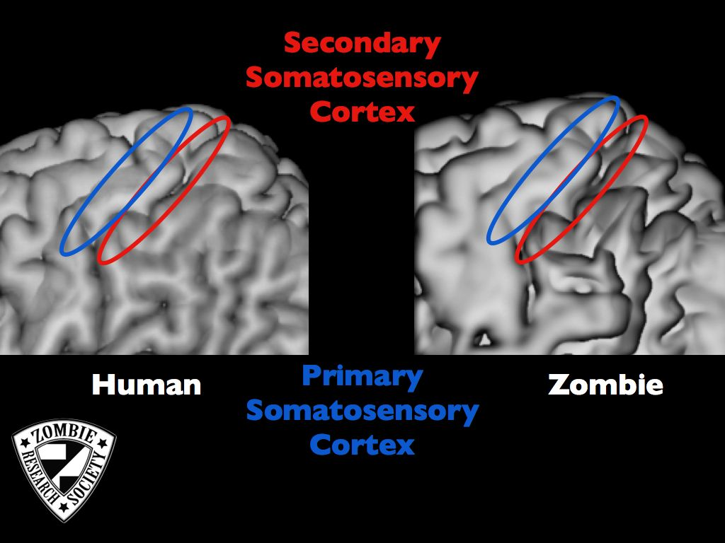
Human brain vs. Zombie brain

Slide 35
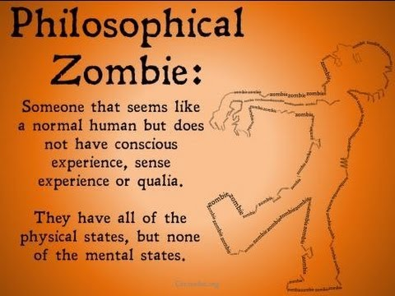
Phil Zombie

Slide 36
Consciência
As três principais noções de consciência são a consciência fenoménica, a consciência de acesso e a consciência reflexiva (Ned Block)
O termo “consciência” é aqui usado para designar apenas a consciência fenoménica, um conjunto de estados mentais que se caracterizam por terem uma certa fenomenologia, serem internamente sentidos de uma certa maneira, terem certas qualidades subjectivas (qualia)
Exemplos (alguns dramáticos)
Ver o vermelho de um pôr do sol africano
Sentir o pó do giz nas unhas
Cheirar peixe muito podre
Ter um orgasmo
Sentir um arrepio
Sentir o aroma do café
Sentir o gosto do próprio vómito
Estas qualia podem ser potenciadas ou alteradas através do uso de coisas como canabinóides, whiskey em jejum, cogumelos alucinogéneos, etc.

Slide 37
C-Fibers
Following an established tradition in philosophy, and merely for convenience of exposition, I shall use henceforth the term " C-fiber firing" to refer to the neural correlate of pain
I am aware that this is inadequate from the point of current neuroscience, as pain is surely a much more complex neurophysiological phenomenon
"C-fiber firing or A-Δ fiber firing" would be more adequate (N. Grahek, Feeling Pain and Being in Pain. Cambridge: The MIT Press, 2007. Chapter 8.)
Both C-fibers and A-Δ fibers are noniceptive fibers, as they both respond preferentially to noxious stimuli
C-fibers elicit burning or dull pain, while A-Δ fibers elicit sharp or prickling pain

Slide 38
Abstract
Type physicalism is the view that every instantiated mental property or type of mental state is identical to some physical property or type of brain state.
This talk tackles the question whether a familiar modal argument against type physicalism, inspired in well-known arguments deployed by Saul Kripke and David Chalmers, is implicitly committed to some form of luminosity with respect to phenomenal or conscious mental states.
As introduced by Timothy Williamson in his book Knowledge and Its Limits, the notion of luminosity applied to phenomenal states or experiences boils down to the following two claims
(a) if a subject s is in a phenomenal state e at a time t, then s is in a position to know at t that s is in e (if someone is in pain on a given occasion, then she is in a position to know on the occasion that she is in pain)
(b) if a subject s is not in a phenomenal state e at a time t, then s is in a position to know at t that s is not in e (if someone is not in pain on a given occasion, then she is in a position to know on the occasion that she is not in pain).
The talk argues that the modal argument in question, on at least one natural reading of it, is indeed committed to the view that phenomenal states, taken as mental states individuated by their characteristic phenomenology, are luminous in the above sense.
On the assumption that Williamson´s arguments against the luminosity of the mental are in the end forceful, one would then be able to block the modal argument on that basis, being thus in a position to rescue type physicalism from some such line of attack.

